Slide 1
File Input/Output (I/O) in C Dr. Neslisah Torosdagli

Slide 2
Contents
File I/O intro
How to create a file pointer
How should we check the file exist or not
Different modes of opening a file
Reading from an input file
Closing a file pointer
Example: fgetc and fputc
Example: fgets
Example: fscanf and fprintf
Example: reading file and string the data in arrays to process the data
List of important functions
rewind() and Search operation.
fseek
Example: searching in a file and updating the file with the help fo
fseek

Slide 3
File I/O intro
So far we have entered information into our programs via the computer's keyboard.
Although this works fine for small sets of input, this would be very time consuming for processing large amounts of data.
Furthermore, large amounts of data often already exist in text files. It would certainly be wasteful to type these data in by hand while running a program when they are already available in a file.

Slide 4
File I/O Intro
C provides the ability to read from files, (AND write to files.)
In fact, when we read information from the keyboard and wrote
information to the screen, we primarily used the functions
printf
scanf
Similarly, for reading from files and writing to files, we'll use the functions
fprintf
fscanf
The first f in each of these function calls stands for "file."
Here is the specification for each function:
fprintf(file_ptr, ctrl_str, other_arguments)
fscanf(file_ptr, ctrl_str, other_arguments)
You'll notice that these are identical to printf and scanf EXCEPT for
the first parameter.

Slide 5
How to Create a File Pointer
In order to read from a file, or write to a file, you MUST use a pointer to that file.
Here is a declaration of a file pointer:
FILE *fp;
This file pointer is not pointing to any file yet.
In order to properly "initialize" a file pointer, it must be set to point to a file.
In order to do this, we must specify the following:
1) Name of the file
2) Mode ("r" for read or "w" for write)
There is a function call that uses this information to open the appropriate file and return a pointer to it.
It's name is fopen.
Here is an example of its use:
fp = fopen("input.txt", "r");
This line look for input.txt file in the same directory where the code is running, and the open the file in read mode. The file pointer is pointing to the beginning of the file

Slide 6
How to Create a File Pointer
Here is an example of fopen:
fp = fopen("input.txt", "r");
You'll notice that the first parameter to the fopen function is a string storing
the name of the file to be opened.
The second parameter is also a string. For our purposes, this string will either
be "r" or "w " or some other options we will see later.
When we open a file in "r" (reading) mode,
the file should already exist and the fopen function returns a pointer to the
beginning of that file.
If the file doesn't exist, fopen returns NULL.
Some important note:
To read the input.txt file, you should keep the file in same directory where your code is running
It will not search in your full computer or other folder if you just write input.txt
If you want your code to run files from another folder, you have to provide the
path of the file instead of just writing “input.txt”
For example:
fopen(“c:/documents/input.txt", "r");

Slide 7
We should check whether we found the file or not
The following piece of code can be used to see whether your program
managed to open the file or not:
FILE *fp;
if ((fp = fopen("myfile.c", "r")) ==NULL)
{
printf("Error opening file\n"); exit(1);
}

Slide 8
The different values for mode are as follows:
Value Description
r Open a file for reading.
w Create a file for writing.//if you have a file with same name, it
will replace the file.
a
r+
w+
Append to a file.
Open a file for read/write. The file must exist
Create a file for read/write. opens a text file in both reading and
writing mode. If the file exists, it's truncated first before overwriting. Any old data will be lost. If the file doesn't exist, a new file will be created.
a+ Append or create a file for read/write. // file is created if does
not exist
There are many other modes available

Slide 9
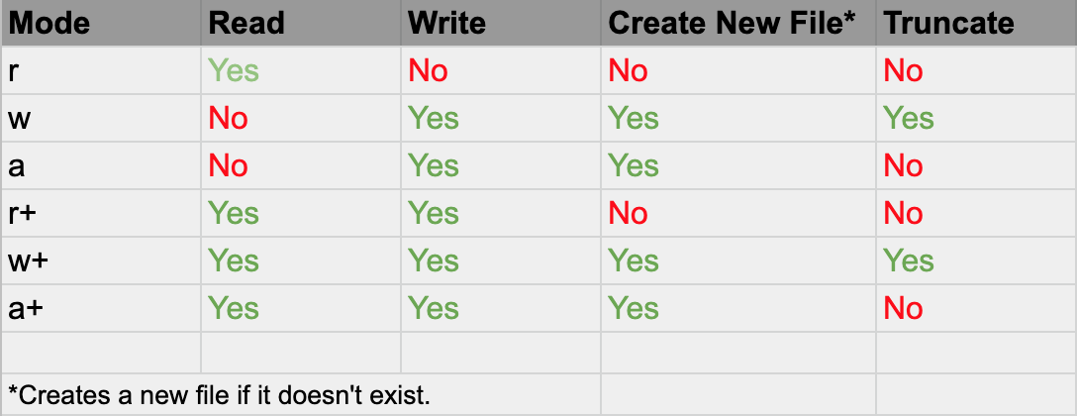

Slide 10
How to Read from an Input File
After opening file in read mode, you can use various functions to read the information from the file
ch=fgetc(fp);
fgetc() reads the character from current pointer position, advances the pointer position so that it now points to the next character and returns the character that is read which we collect to the variable ch.
Once the file is opened, we refer the file through the file pointer fp.
How long should you keep reading?
Until you reach to the end of the file
How do I know I am at the end?
EOF will help you to notice that.

Slide 11
Closing a File:
fclose( ) closes the stream, writes any data remaining in the disk buffer to the file, does a formal operating system level close on the file, and frees the associated file control block.
fclose( ) has this prototype:
int fclose(FILE *fp);
A return value of zero signifies a successful operation.

Slide 12
Example with fgetc(): reads a char from a file
#include <stdio.h> #include <stdlib.h>
int main(void) {
FILE *ifp, *ofp; char ch;
ifp = fopen("in.txt","r");
ofp = fopen("out.txt","w"); //open file in write mode
if(ifp==NULL || ofp == NULL) //if cannot open file
{
printf("Cannot open file \n");
exit(1);
}
while(!feof(ifp)) //loop until ifp reaches to EOF
{
ch = fgetc(ifp); //read a char and move ifp forward
if (ch!=EOF)
{
printf("%c", ch);
fputc(ch, ofp);//put a char and move ofp forward
}
}
fclose(ifp); //close the ifp fclose(ofp);//close the ofp
return 0;
}
This code reads a text file with name in.txt, prints all the information in the file in the console and also to a new file out.txt
Before running this code, you should keep a text file with some data/text in it and place it in the same folder of your code
As you are reading character by
character, you can process them:
May be count words, count characters, count vowels
Also, store them in char arrays.
In this code, feof() checks whether you reached to the EOF or not.
//open file in read mode

Slide 13
Example with fgets(): reads a line from a file
Prototype of fgets() function:
char *fgets(char *str, int n, FILE
*stream)
Parameters
str − This is the pointer to an array of
chars where the string read is stored.
n − This is the maximum number of characters to be read (including the final null-character). Usually, the length of the array passed as str is used.
stream − This is the pointer to a FILE object that identifies the stream where characters are read from.
Note that fgets() will also keep the ‘\n’
in your string str.
To remove that ‘\n’ from your string,
you can use the foollwing line:
str[strcspn(str, "\n")] = 0;
#include <stdio.h>
#include <stdlib.h>
int main(void) { FILE *ifp; char str[100];
ifp = fopen("in.txt","r"); if(ifp==NULL) //if cannot open file
{
printf("Cannot open file \n");
exit(1);
//return 0;
}
while( fgets (str, 100, ifp)!=NULL )
{
str[strcspn(str, "\n")] = ‘\0’; //remove ‘\n’ from str
puts(str); //print str
}
fclose(ifp); //close the file
return 0;
}

Slide 14
fscanf and fprintf
Like scanf and printf for console, we can use fscanf and fprintf for
taking data from file and putting data into a file.
Your input file needs to be properly formatted to read using fscanf.
For example, if you want to read an integer using fscanf, your input
file also should contain integer at a specific part of the file.
Let us consider the following content of a students.txt file
5
861022 Adam 65 72 56
851102 Allan 78 45 80
860501 Smith 55 75 90
841205 Ahmed 75 80 95
850630 Puja 40 50 48
The first integer in the file says, how many students information are
available in the file.
Next, 5 lines contain the student information of 5 students. One student for each line. It includes, student id number, student last name, and scores for 3 Courses. All data are separated by space.

Slide 15
fscanf and fprintf
Content of a students.txt file
5
861022 Adam 65 72 56
851102 Allan 78 45 80
860501 Smith 55 75 90
841205 Ahmed 75 80 95
850630 Puja 40 50 48
Now, we will write a program that reads the students.txt file and produce out.txt file with the student id, student last name, and average grade for the students from the three grade provided in the students.txt file.

Slide 16
fscanf and fprintf
Students.txt 5
#include <stdio.h>
int main () {
861022 Adam 65 72 56
851102 Allan 78 45 80
860501 Smith 55 75 90
841205 Ahmed 75 80 95
850630 Puja 40 50 48
FILE * infile; FILE * outfile;
int student_ID, j,g1,g2,g3, n;
char student_name[30]; float avg;
infile = fopen("students.txt", "r" ); //read mode
outfile = fopen("students_avg.txt" , "w");//write mode
fscanf(infile, "%d",&n); //read the first integer
for (j =1; j <= n; j++) { //loop n number of times to read n students
fscanf( infile, "%d", &student_ID); //read student id
fscanf( infile, "%s", student_name); //read last name
fscanf( infile," %d %d %d ", &g1, &g2, &g3); //read 3 grades
avg = (g1+g2+g3)/3.0;
printf("%d %s %d %d %d %.2f\n", student_ID, student_name, g1, g2,g3,
avg);
fprintf(outfile,"%d %s %.2f\n", student_ID, student_name, avg);
}
fclose(infile); //close infile
fclose(outfile); //close outfile. Data will not be written if you do not close
return 0;
}

Slide 17
Modifying student_grade code
Now, if we want to print the student who got highest grade or if we want to store them in an array, how would you approach?
We will also add another integer in the input file’s first line
that represents number course grade per students.
Students.txt
5 3
861022 Adam 65.5 72 56
851102 Allan 78 45.5 80
860501 Smith 55 75 90
841205 Ahmed 75 80 95
850630 Puja 40 50 48
We have three different types of data
Integer, string, and float
There are 3 float numbers per student (if three courses)
So, we will declare:
An integer array: int ids[MAX_SIZE]
An array of strings: char Lnames[MAX_SIZE][20]
A 2D array of float: float grades[MAX_SIZE][COURSE_SIZE]
How would we track the students across three arrays?
The index 0 for all the array will be for first student
Next index will be for second student, etc.

Slide 18
#include <stdio.h> #define MAX_SIZE 100
#define MAX_COURSES 10 int main () {
FILE * infile;
FILE * outfile;
int ids[MAX_SIZE], n, courses, char LNames[MAX_SIZE][20];
// we have all the data in our arrays now!
float max_avg = -1.0;
int max_index=0;
for (i =0; i < n ; i++) {
if (avgs[i]>max_avg){ max_avg = avgs[i]; max_index = i;
}
i, j;
float grades[MAX_SIZE][MAX_COURSES];
float avgs[MAX_SIZE];
infile = fopen("students2.txt", "r" );
}
fprintf(outfile, "============\nStudent
outfile = fopen("students_avg2.txt" fscanf(infile, "%d",&n); fscanf(infile, "%d",&courses); fprintf(outfile, "List of students data\n==========\n");
float total;
for (i =0; i < n ; i++) {
total = 0.0;
, "w");
with highest average score: \n");
fprintf(outfile,"%d %s %.2f\n",
ids[max_index], LNames[max_index],
avgs[max_index]);
fclose(infile); // Close both files.
fclose(outfile);
printf("Please see the students_avg.txt
fscanf( infile, "%d", &ids[i]); fscanf( infile, "%s", LNames[i]);
for(j=0; j<courses; j++) { //get courses
file for result");
return 0;
}
number of grades for student i
fscanf( infile," %f", &grades[i][j]); total += grades[i][j];
}
Students.txt 5 3
861022 Adam 65 72 56
851102 Allan 78 45 80
860501 Smith 55 75 90
841205 Ahmed 75 80 95
850630 Puja 40 50 48
avgs[i] = total/courses;
fprintf(outfile,"%d %s %.2f\n", ids[i],
LNames[i], avgs[i]);
}

Slide 19


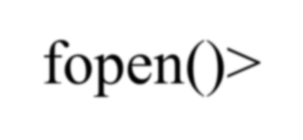

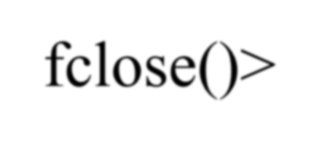










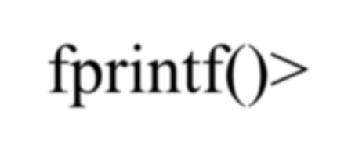






Function | Description
fopen()> | Opens a file.
fclose()> | Closes a file.
fputc()> | Writes a character.
fgetc()> | Reads a character.
fprintf()> | Is to a file what printf() is to the console.
fscanf()> | Is to a file what scanf() is to a console.

Slide 20
Example of using rewind and menu based search
When you perform a single search in a file, the file pointer moves forward and maybe it can reach to the end of the file if the item you are looking for does not exist.
If you want to perform a search operation in a file one after another, then you need to move the file pointer to the beginning after every search operation.
rewind() is a function that can move the file pointer to the
beginning. You just need to pass file pointer to this function.
See the example in the next slide!
For the example we will consider the following file data:
861022 Adam 65 72 56
851102 Allan 78 45 80
860501 Smith 55 75 90
841205 Ahmed 85 70 95
850630 Puja 40 50 48

Slide 21
int main ()
{
FILE * infile;
int id, n, courses, i, j, g1, g2, g3;
char LName[20];
rewinding before every search
char search_key[20], new_name[20]; infile = fopen("students4.txt", "r" ); char ch;
while(1){
printf("Menu:\n1. Search by Name\n2. any other key to exit: "); ch = getchar();
if(ch == '1')
{
rewind(infile); // moves the file pointer to the beginning char search_key[20];
printf("Enter a name to search: "); scanf("%s", search_key); printf("Looking for %s\n", search_key); int found = 0;
while(fscanf( infile, "%d %s %d %d %d", &id, LName, &g1, &g2, &g3) != EOF)
{
if(strcmp(search_key, LName)==0) { found = 1;
printf("We found %s in our record\n", search_key);
printf("ID: %d, Name: %s Grades: %d %d %d\n", id,LName,g1,g2, g3); break;
}
}
The code continues to the next slide

Slide 22
if(!found)
printf("Sorry could not find the name\n");
}
else //if the your pressed other key
{
printf("Thanks for using our search system\n");
break;
}
char cleanup;
while((cleanup=getchar() != '\n') && cleanup != EOF); // flushing the ‘\n’ pressed when entering the last name to keep the code taking input
}
return 0;
}

Slide 23
Use of fseek and editing file
If you have observed all of our file I/O codes so far just sequentially read the file.
We read/write from/to the file based on exact position of the file pointer at a
particular moment
Whenever you read something from the file, the file pointer moves forward
fseek is a function that can be used to move the cursor to
different places of your file
Here is the prototype:
int fseek(FILE *pointer, long int offset, int position)
pointer: pointer to a FILE object that identifies the stream.
offset: number of bytes to offset from position (can be negative too)
position: position from where offset is added.
returns: zero if successful, or else it returns a non-zero value
position defines the point with respect to which the file pointer needs
to be moved by offset. It has three values:
SEEK_END : It denotes end of the file. SEEK_SET : It denotes starting of the file.
SEEK_CUR : It denotes file pointer’s current position.

Slide 24
Example of using fseek() to edit our file
Now, we will write a code where we will open a file in r+ mode
So we will be able to both read and write using same pointer
We will use the same file we used in our last examples
We will ask the user to provide a name to search and to provide a modified
name so that we can update our file
Strategy:
We will start reading the file from the beginning as we did in our earlier examples
When we read a name, we will compare it with the search key and if matches
We will move the file pointer backwards by the length of the search key so that we can replace it!
Let’s see the code in the next slide

Slide 25
fgetpos
#include <stdio.h>
int main () {
FILE *fp;
fpos_t position;
fp = fopen("file.txt","w+");
fgetpos(fp, &position);
fputs("Hello, World!", fp);
fsetpos(fp, &position);
fputs("This is going to override previous content", fp);
fclose(fp);
return(0);
}

Slide 26
ftell
// C program to demonstrate use of ftell()
#include<stdio.h>
int main()
{
/* Opening file in read mode */
FILE *fp = fopen("test.txt","r");
/* Reading first string */
char string[20];
fscanf(fp,"%s",string);
/* Printing position of file pointer */
printf("%ld", ftell(fp));
return 0;
}

Slide 27
File Position Access and Manipulation
long int ftell(FILE *stream)
int fseek(FILE *stream, long int offset, int whence)
SEEK_END − End of file.
SEEK_SET − Starting of file.
SEEK_CUR − Current position of file pointer.
void rewind(FILE *stream);
int fgetpos(FILE *stream, fpos_t *pos);
int fsetpos(FILE *stream, const fpos_t *pos);

Slide 28
#define MAX_SIZE 100
#define MAX_COURSES 10
//remaining part of the code from the left side
int main () {
FILE * infile;
int id, n, courses,
char LName[20];
if(i==n)
printf("Name does not exist.");
i, j;
fclose(infile); // Close both files.
float grades[MAX_COURSES];
char search_key[20], new_name[20];
infile = fopen("students3.txt", "r+" );
printf("File updated if found.");
return 0;
}
fscanf(infile, "%d",&n); fscanf(infile, "%d",&courses);
printf("Enter a name to edit and the new name: "); scanf("%s %s", search_key, new_name); printf("Finding the student...\n");
for (i =0; i < n ; i++) { fscanf( infile, "%d", &id);
fscanf( infile, "%s", LName);
if(strcmp(search_key, LName)==0)
{
printf("Found the name. Updating..."); fseek(infile, -strlen(LName), SEEK_CUR); fprintf(infile, "%s",new_name);
break;
}
for(j=0; j<courses; j++) {
fscanf( infile," %f", &grades[j]);
fseek moves the cursor to the
beginning of the name found
//subtract string length from the current position of the pointer
After moving the pointer, write the new_name to replace it.
They can be in different lenght
}
However, this code has a problem as if the new name length is not exact same as the name you are replacing, then it will keep
}
older char or replace some grades with the new string if it is longer. There are various logic to deal with that. Maybe you can
keep/load the full data in your code and write a new temp file, remove the old file and rename the temp file to the original file name. You can use remove, rename functions. But we leave it up to here and you can explore further. Use this logic as the starting point.

